Slide 1
ESTIMATION
(1 to 8 slides are optional)
MT 205: Probability & Statistics

Slide 2
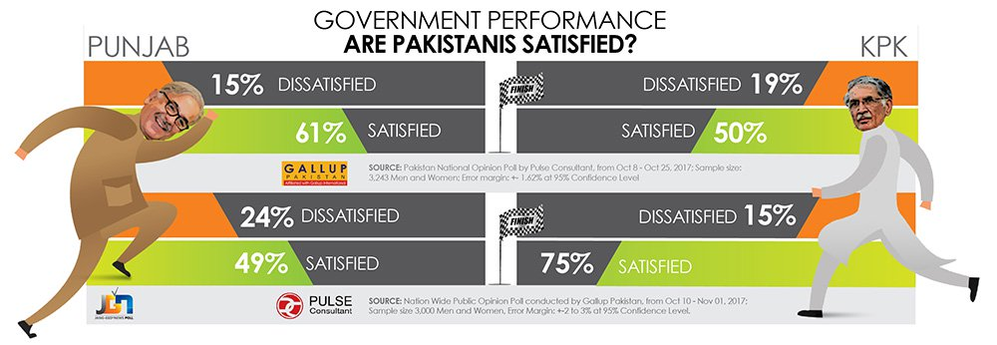
22 November 2017, The News
Majority of Pakistanis approve of Punjab, KP govts’ performance – Gallup Pakistan National Public Opinion Poll cited in The News.

Slide 3
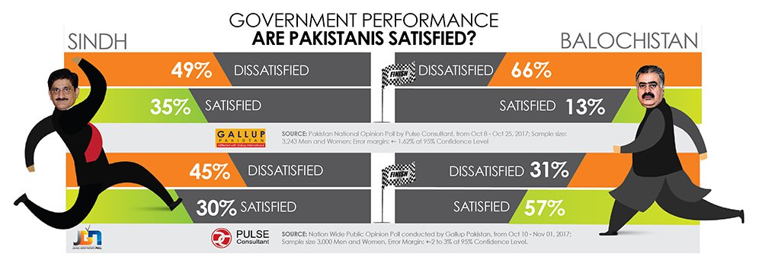

Slide 4
22 November 2017, The News
The results represent public opinion computed on the basis of views expressed by anonymous respondents selected randomly and interviewed face-to-face. Such surveys contain a margin of error, and should not be taken as a basis for casting votes.
The combined sample size of the study was more than 6,000 households. Gallup Pakistan carried out the survey from October 10 to November 1 using an error margin of +-2 to 3% at 95% confidence level, while the parallel research by Pulse Consultant was conducted from Oct 8 to Oct 25 with a margin of error of 1.62% at 95% confidence level.

Slide 5

What do Pakistanis consider the country's biggest problems? (23 November 2017)
https://www.geo.tv/latest/168978-what-do-pakistanis-consider-the-countrys-biggest-problems-heres-what-our-survey-revealed

Slide 6
Note from Editor/Disclaimer: The Jang-Geo-News poll is carried out regularly on a national level according to internationally recognised principles of scientific polling. Large media houses across the world carry out these surveys to assess the perception and opinions of the public.
In order to make it more balanced and transparent, the Jang-Geo-News poll was carried out in collaboration with two different research agencies—Gallup Pakistan, one of the renowned survey companies in Pakistan, and Pulse Consultant, one of the fastest growing research agencies in the country.
The results represent public opinion computed on the basis of views expressed by anonymous respondents selected randomly and interviewed face-to-face.
The combined sample size of the study was more than 6,000 households. Gallup Pakistan carried out the survey from October 10 to November 1 using an error margin of +-2 to 3% at 95% confidence level, while the parallel research by Pulse Consultant was conducted from Oct 8 to Oct 25 with a margin of error of 1.62% at 95% confidence level.

Slide 7
Several questions arise:
How do these estimates compare with the true population percentages?
What is meant by a margin of error?
Is the sample of 6000 large enough to represent the population.

Slide 8

Introduction
One aspect of inferential statistics is estimation, which is the process of estimating the value of a parameter from information obtained from a sample. For example, The Book of Odds, by Michael D. Shook and Robert L. Shook contains the following statements:

Slide 9


Two types of Estimation

Slide 10
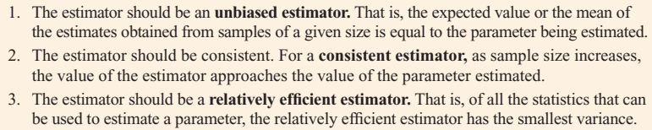
Properties of a Good Estimator
Sample measures (i.e., statistics) are used to estimate population measures (i.e., parameters). These statistics are called estimators.
A good estimator should satisfy the three properties:

Slide 11
Confidence Interval
Either the interval contains the parameter or it does not.
A degree of confidence can be assigned before an interval estimate is made.
For instance, you may wish to be 95% confident that the interval contains the true population mean.
If you desire to be more confident, such as 99 or 99.5% confident, then you must make the interval larger. For example, a 99% confidence interval for the mean age of college students might be

Slide 12
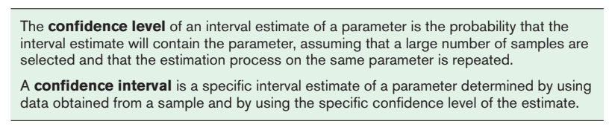
Intervals constructed in this way are called confidence intervals. Three common confidence intervals are used: the 90, the 95, and the 99% confidence intervals.

Slide 13
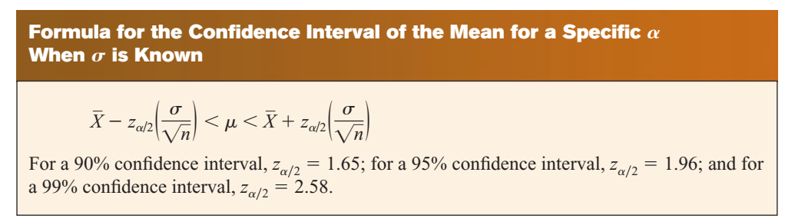
Margin of Error = the maximum error of the estimate.
For a specific value, say, a α = 0.05, 95% of the sample means will fall within this error value on either side of the population mean.
Notes:
Margin of Error = the maximum error of the estimate.

Slide 14
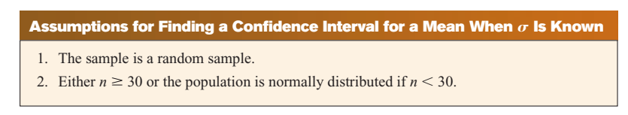

Slide 15

Example # 01 – 02
Days It Takes to Sell an Aveo: A researcher wishes to estimate the number of days it takes an automobile dealer to sell a Chevrolet Aveo. A sample of 50 cars had a mean time on the dealer’s lot of 54 days. Assume the population standard deviation to be 6.0 days. Find the best point estimate of the population mean and the 95% confidence interval of the population mean.
Waiting Times in Emergency Rooms: A survey of 30 emergency room patients found that the average waiting time for treatment was 174.3 minutes. Assuming that the population standard deviation is 46.5 minutes, find the best point estimate of the population mean and the 99% confidence of the population mean.

Slide 16
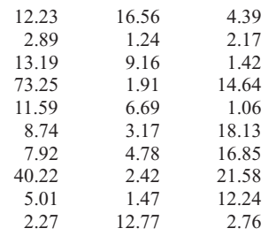

Example # 03: Credit Union Assets
The following data represent a sample of the assets (in millions of dollars) of 30 credit unions in southwestern Pennsylvania. Find the 90% confidence interval of the mean.
Notes:
Sample mean = 11.09 , alpha/2=0.05 (1 – 0.05 = 0.9500) 🡪 z-value = 1.65

Slide 17
Sample Size
Sample size determination is closely related to statistical estimation.
Quite often you ask, How large a sample is necessary to make an accurate estimate?
it depends on three things: the margin of error, the population standard deviation, and the degree of confidence.

Slide 18
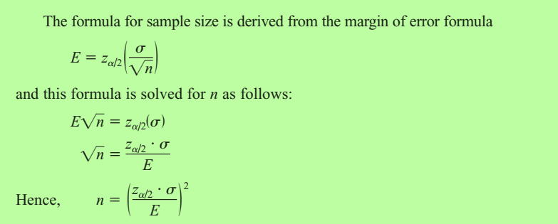

Slide 19

Example # 04
Depth of a River: A scientist wishes to estimate the average depth of a river. He wants to be 99% confident that the estimate is accurate within 2 feet. From a previous study, the standard deviation of the depths measured was 4.33 feet.

Slide 20
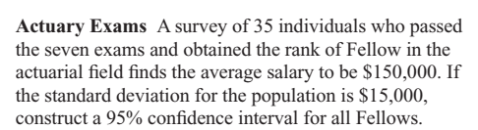
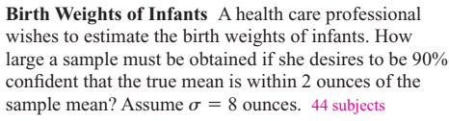

Slide 21
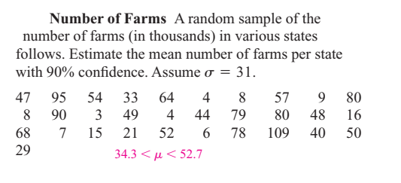

Slide 22

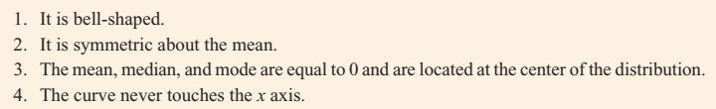
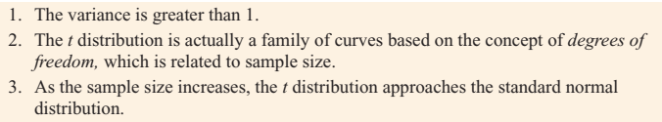
Properties of t-distribution)

Slide 23
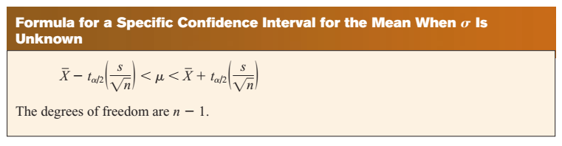

Slide 24
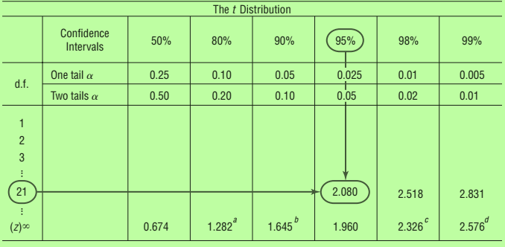
Example # 05

Slide 25
Example # 06
Sleeping Time: Ten randomly selected people were asked how long they slept at night. The mean time was 7.1 hours, and the standard deviation was 0.78 hour. Find the 95% confidence interval of the mean time. Assume the variable is normally distributed.
Notes:
T=2.262

Slide 26

the data represent a sample of the number of home fires started by candles for the past several years. (Data are from the National Fire Protection Association.) Find the 99% confidence interval for the mean number of home fires started by candles each year.
Notes:
T=3.707 xbar=7041..4

Slide 27
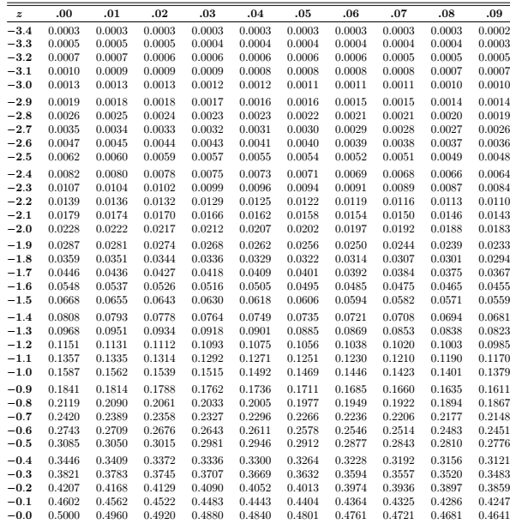

Slide 28
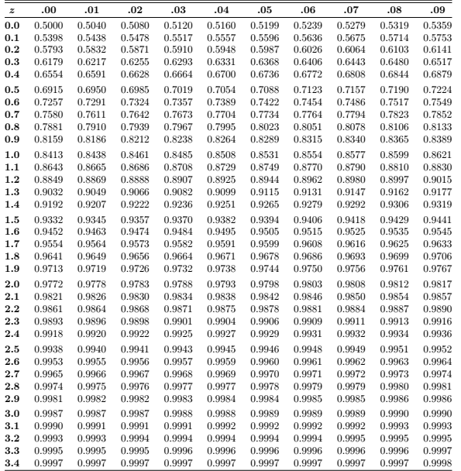

Slide 29
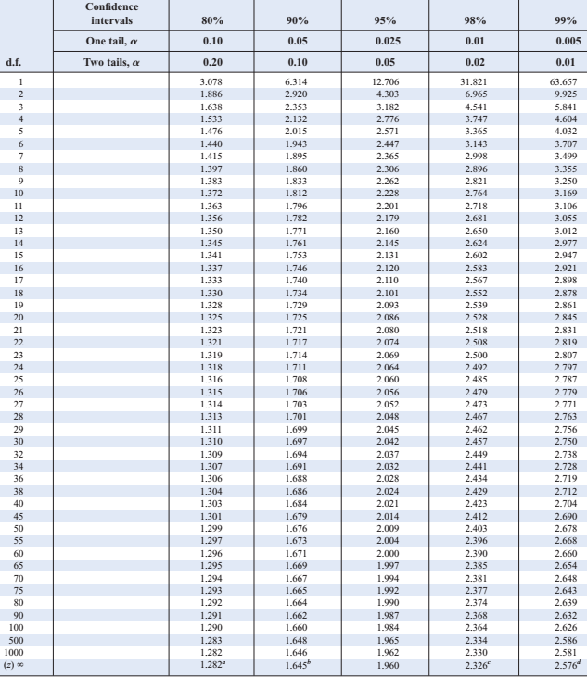
T-table

Slide 30
Level of Significance | 0.10 | 0.05 | 0.01
H₁: µ > µ_{o} or µ < µ_{o} | +1.28, - 1.28 | +1.64, -1.64 | +2.33, -2.33
H1: µ ≠ µ_{o} | +1.64, -1.64 | +1.96, -1.96 | +2.58, - 2.58

Slide 31
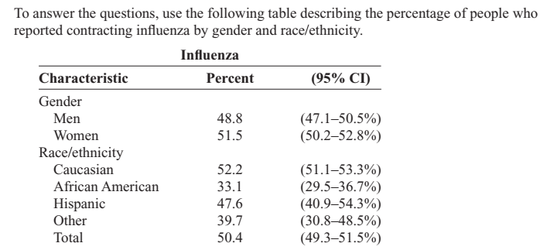
Example # 13: Contract Influenza

Slide 32
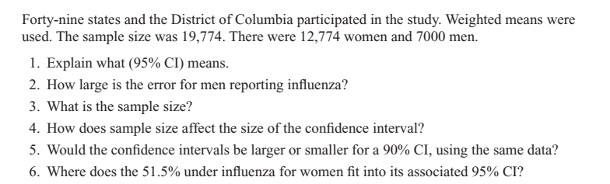
Example # 13 (contd.)
these are the 95% confidence intervals constructed from the data.
MarginError= (50.5 - 47.1)2 = 1.7%.
19774
The larger the sample size, the smaller the margin of error
6. The 51.5% is the middle of the confidence interval, since it is the point estimate for the confidence interval.
5. A 90% confidence interval would be narrower (smaller) than a 95% confidence interval, since we need to include fewer values in the interval.

